Slide 1
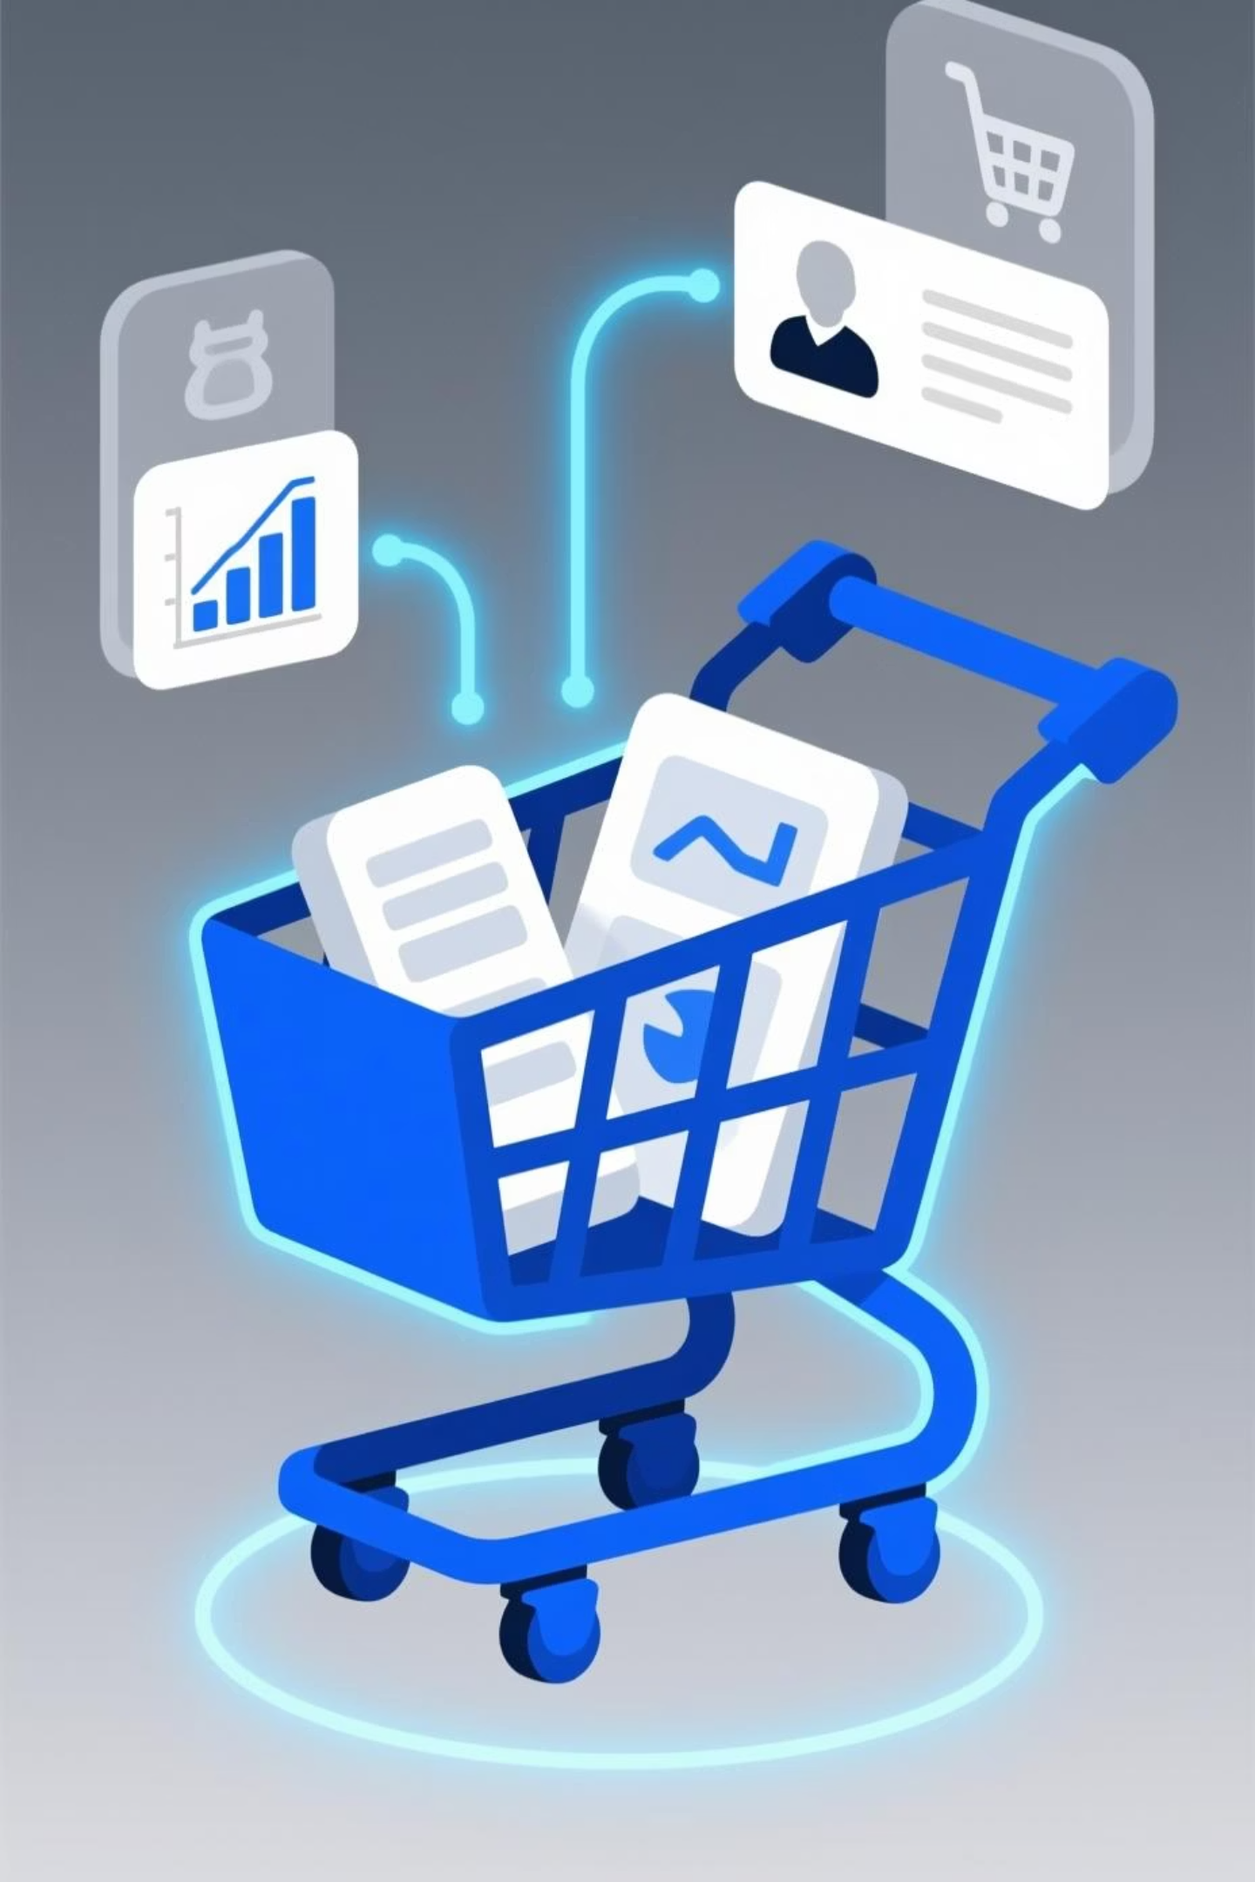
Customer Shopping Behavior Analysis
Uncovering insights from transactional data to drive strategic business decisions.

Slide 2

Project Overview & Dataset Summary
Project Goal
Dataset Details
Missing Data
Analyze 3,900 purchases to understand spending patterns, segments, preferences, and subscription behavior.
3,900 rows, 18 columns. Key features include demographics, purchase details, and shopping behavior.
37 values in 'Review Rating' column, handled during data preparation.

Slide 3
Exploratory Data Analysis: Python
01
02
03
Data Loading & Exploration
Missing Data Handling
Column Standardization
Imported dataset with pandas, checked structure and summary statistics.
Imputed missing 'Review Rating' values using median per product category.
Renamed columns to snake case for improved readability.
04
05
Feature Engineering
Database Integration
Created 'age_group' and 'purchase_frequency_days' columns.
Loaded cleaned data into PostgreSQL for SQL analysis.

Slide 4
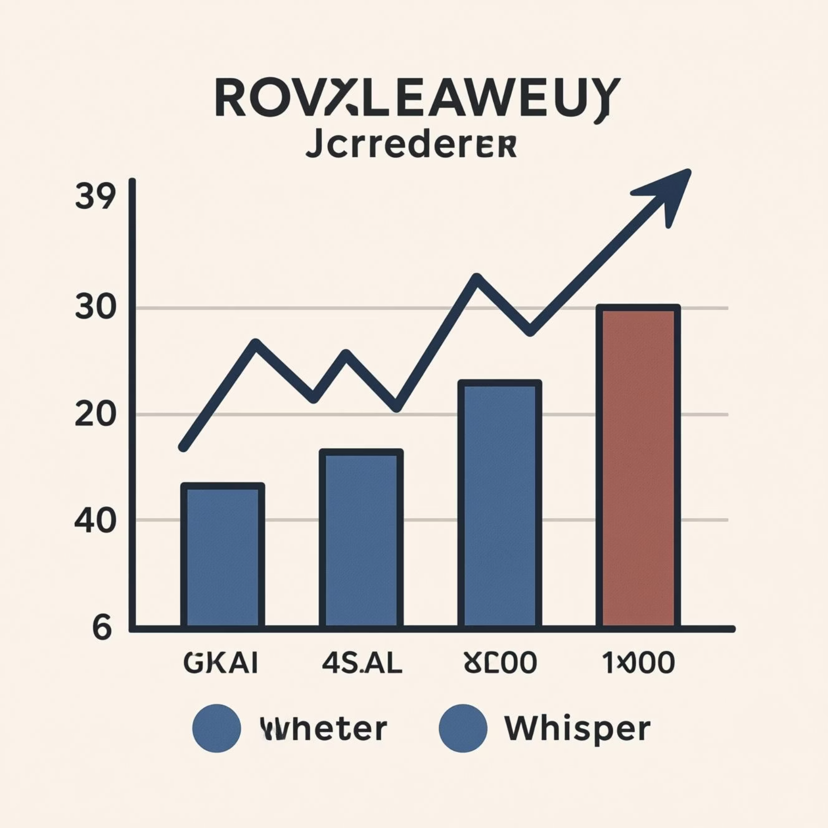

SQL Analysis: Revenue & Discounts
Revenue by Gender
High Spending Discount Users
Male customers generated $157,890, while female customers generated $75,191.
Identified 839 customers who used discounts but still spent above the average purchase amount.

Slide 5
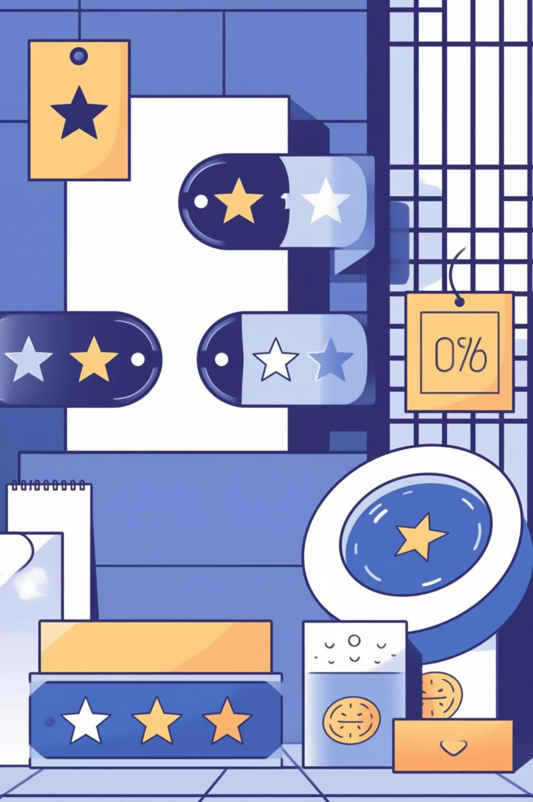

SQL Analysis: Product Performance
Top 5 Products by Rating
Shipping Type Comparison
Gloves (3.86), Sandals (3.84), Boots (3.82), Hat (3.80), Skirt (3.78).
Express shipping had a higher average purchase amount ($60.48) than standard ($58.46).
Discount Dependent Products
Hat (50%), Sneakers (49.66%), Coat (49.07%), Sweater (48.17%), Pants (47.37%) had highest discount rates.

Slide 6
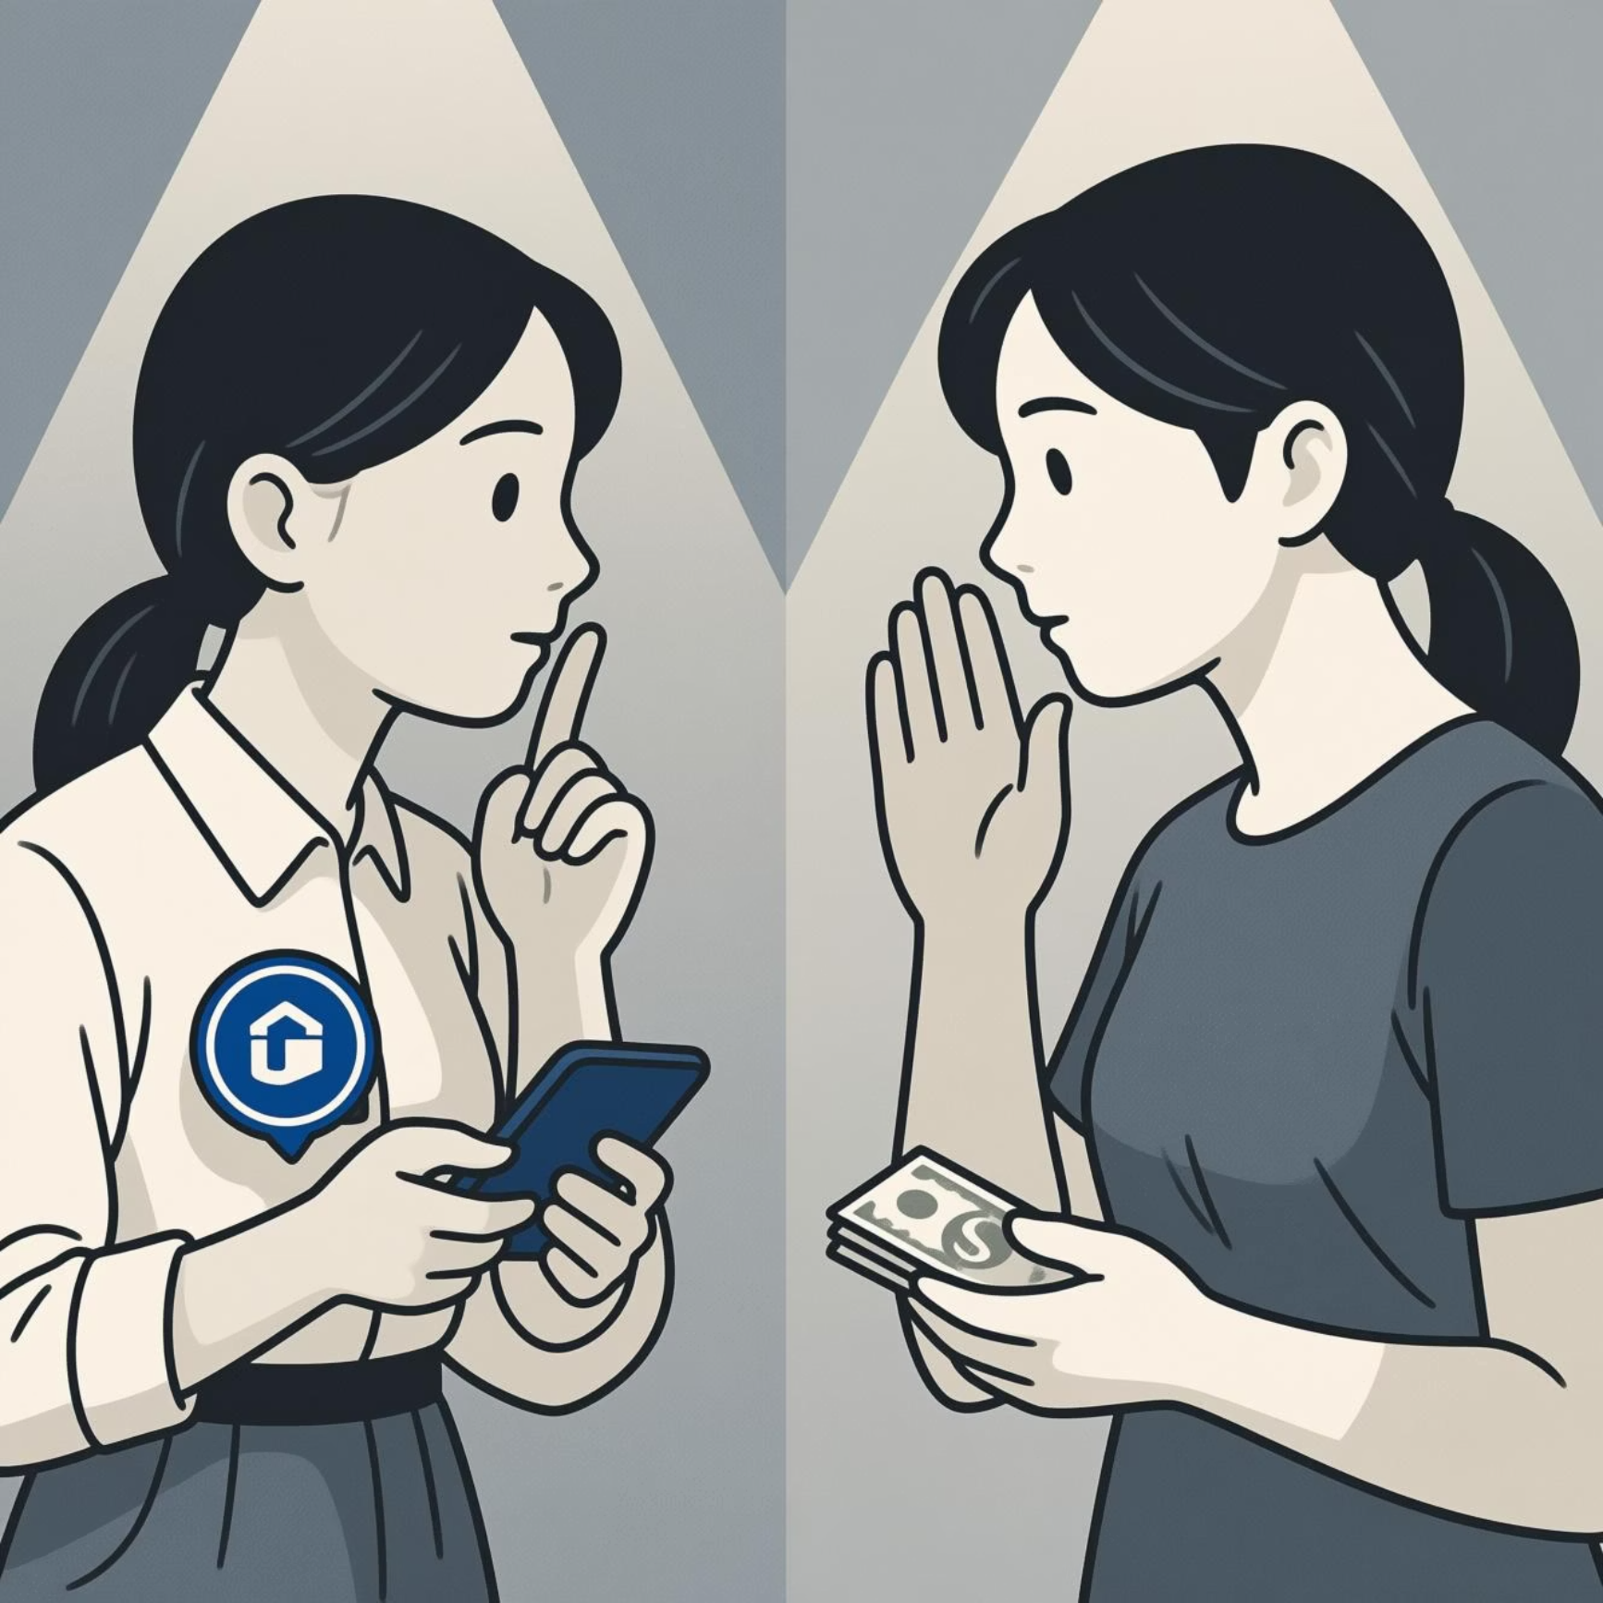
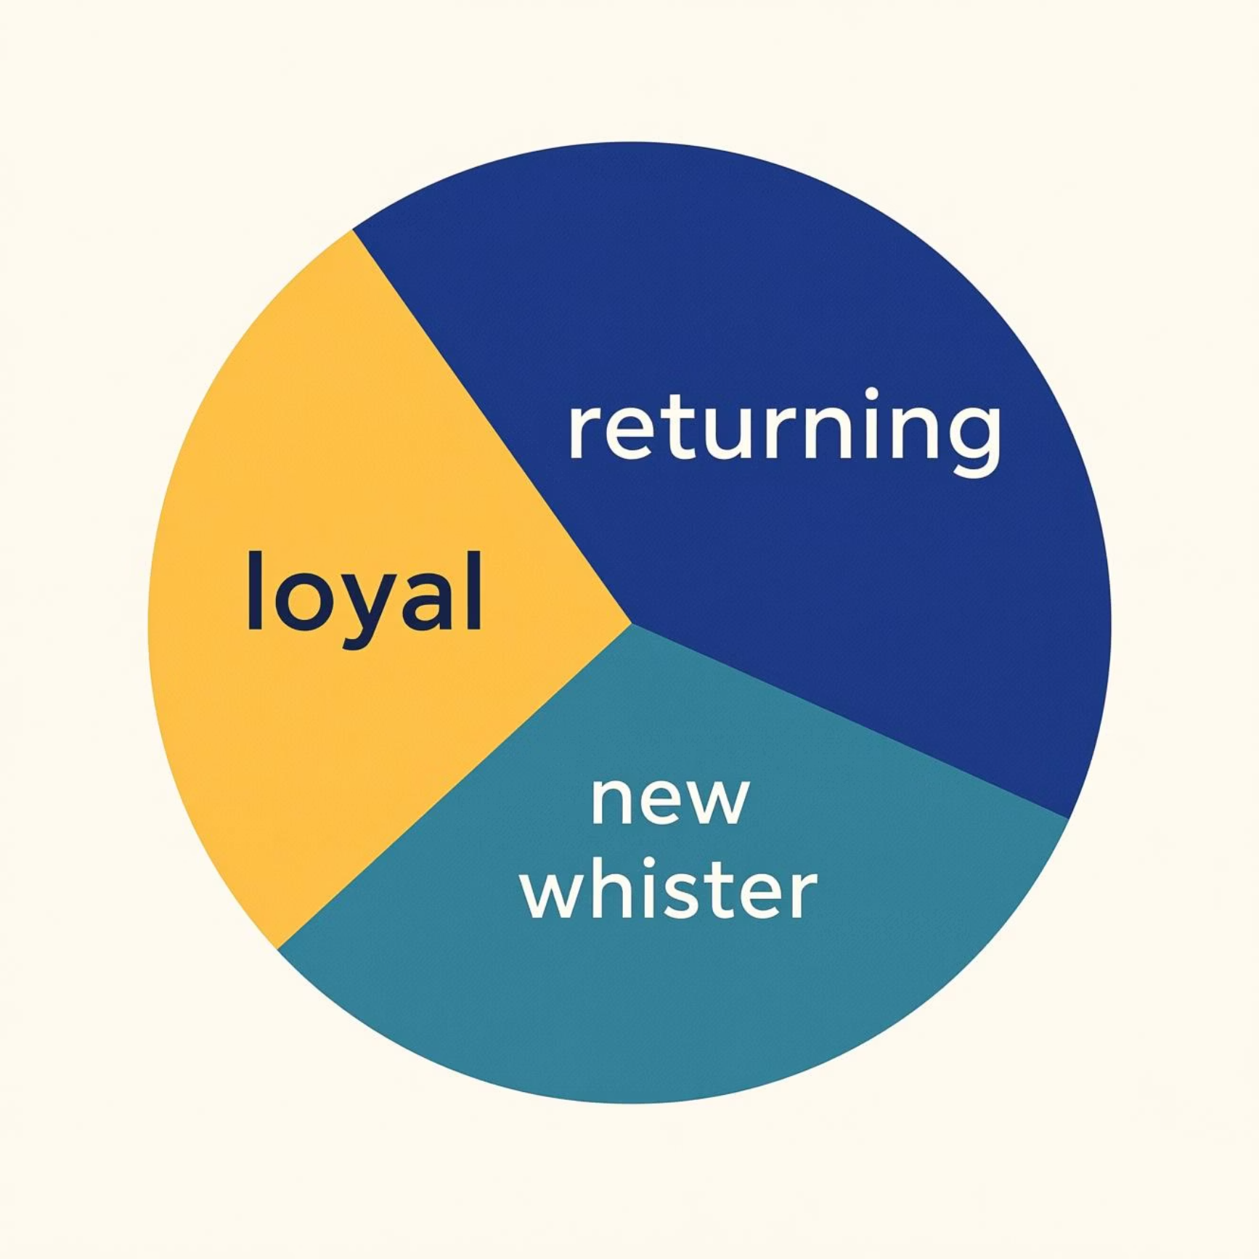
SQL Analysis: Subscription & Segmentation
Subscribers vs. Non-Subscribers
Customer Segmentation
Non-subscribers generated higher total revenue ($170,436) and slightly higher average spend ($59.87) than subscribers ($62,645 total, $59.49 avg.).
Loyal customers (3116), Returning (701), and New (83) segments identified based on purchase history.

Slide 7
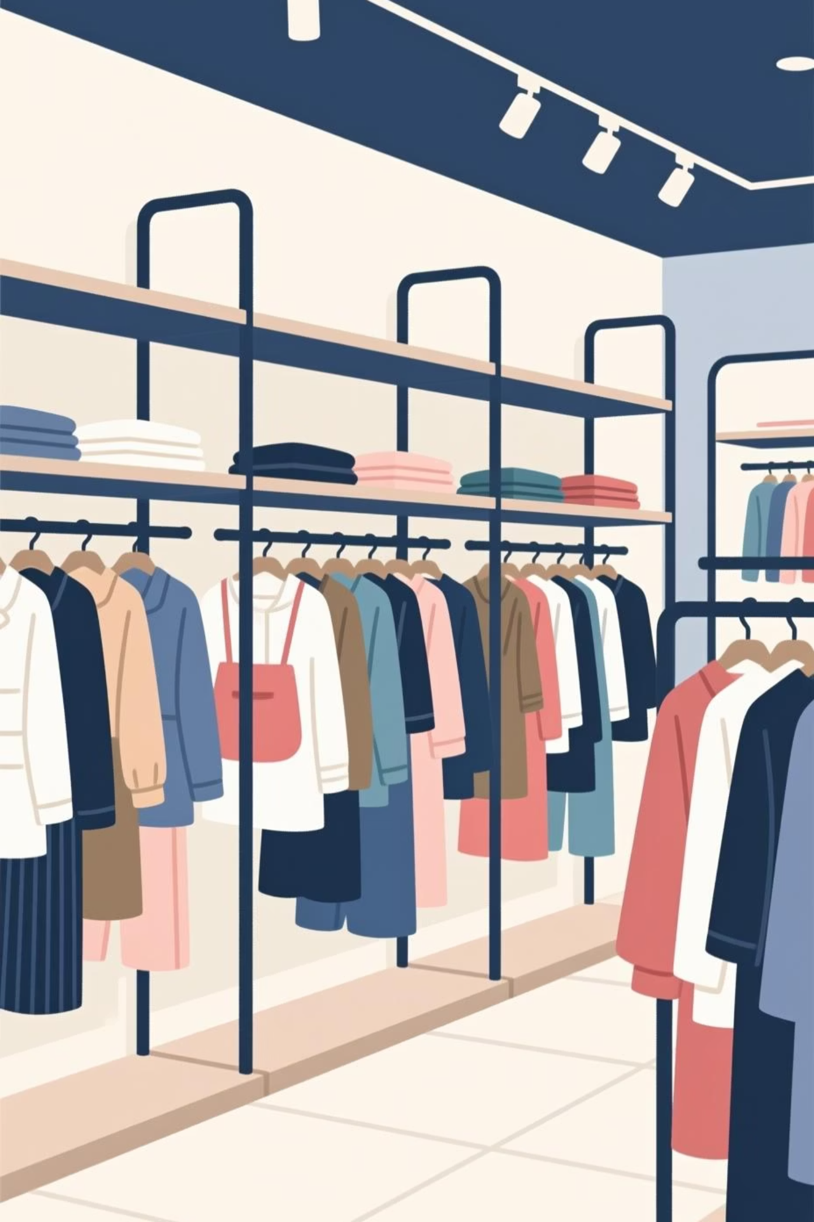
SQL Analysis: Product Categories
Accessories
1
Jewelry, Sunglasses, Belt were the top 3 most purchased.
Clothing
2
Blouse, Pants, Shirt were the top 3 most purchased.
Footwear
3
Sandals, Shoes, Sneakers were the top 3 most purchased.
Outerwear
4
Jacket, Coat were the top 2 most purchased.

Slide 8
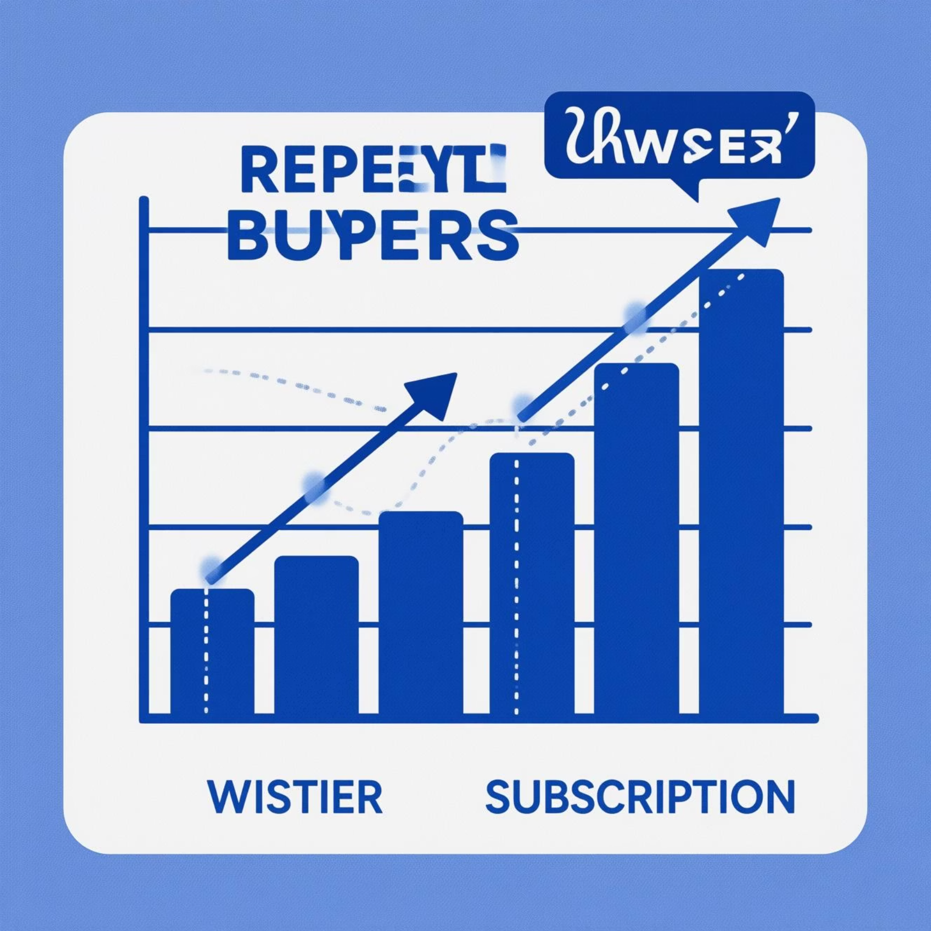
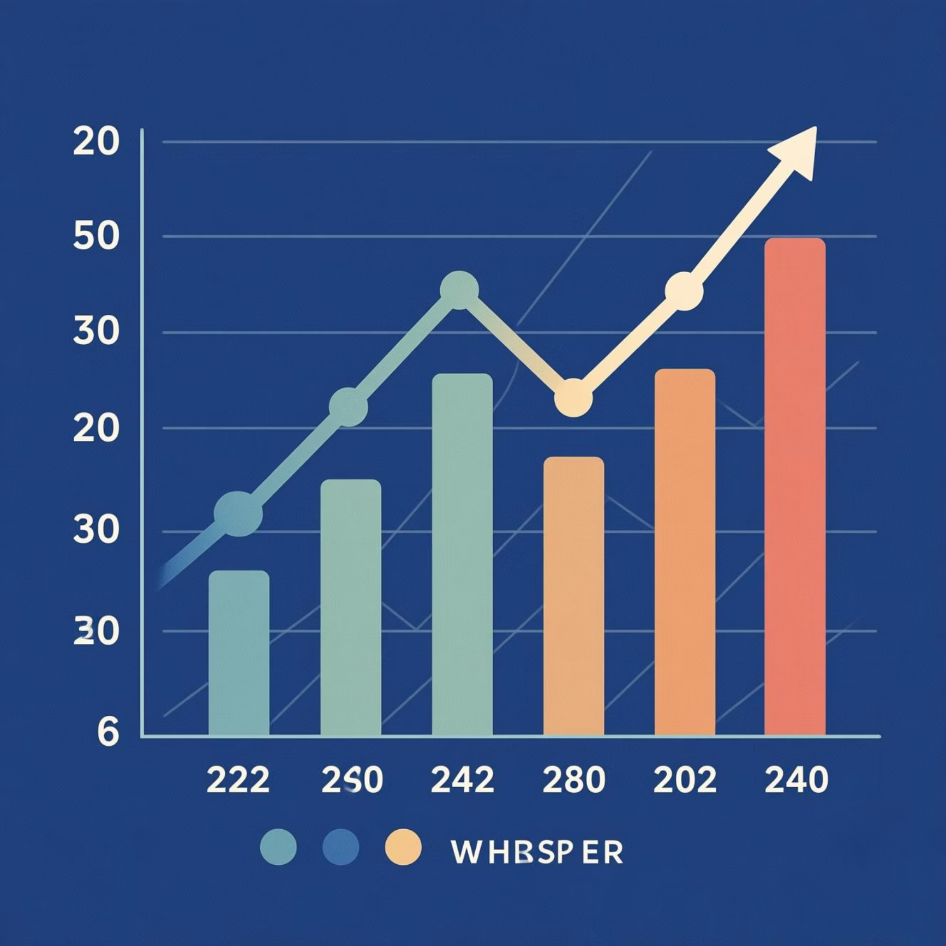
SQL Analysis: Repeat Buyers & Age Groups
Repeat Buyers & Subscriptions
Revenue by Age Group
Of customers with >5 purchases, 958 subscribed, while 2518 did not. This suggests repeat buyers are not necessarily more likely to subscribe.
Young Adults generated the highest revenue ($62,143), followed by Middle-aged ($59,197), Adults ($55,978), and Seniors ($55,763).

Slide 9
Power BI Dashboard: Visualizing Insights
An interactive dashboard was built to visually present key findings and facilitate deeper exploration of customer behavior.
3,900
$59.76
3.75
Customers
Avg. Purchase
Avg. Rating

Slide 10
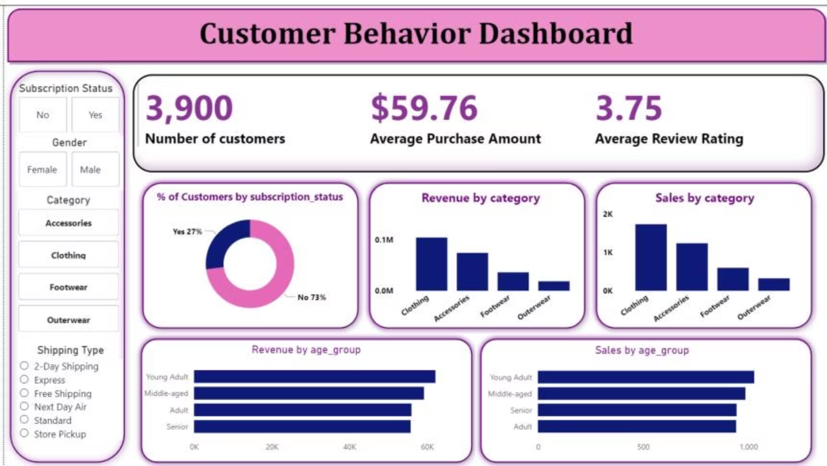
Power BI Dashboard: Interactive Insights
This comprehensive Power BI dashboard provides an interactive overview of customer shopping behavior, allowing stakeholders to delve into key metrics and trends. Explore segments, product performance, and revenue drivers with ease.
The dashboard is designed for dynamic exploration, featuring filters for demographics, product categories, and purchase history, enabling deeper insights for strategic decision-making.

Slide 11





Business Recommendations
Boost Subscriptions
Promote exclusive benefits to increase subscriber base.
Customer Loyalty Programs
Reward repeat buyers to foster loyalty and move them to the "Loyal" segment.
Review Discount Policy
Balance sales boosts with margin control for sustainable growth.
Targeted Marketing
Focus campaigns on high-revenue age groups and express-shipping users.

